Slide 1
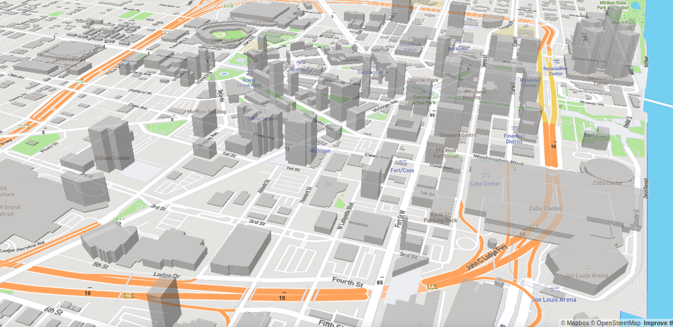
SEMCOG-UrbanSim Bi-weekly
July 25, 2019
Notes:
In this chapter, we will discuss the theoretical basis of UrbanSim at a conceptual level.
Given time constraints, we won’t be able to dive very deeply into the mathematics of the model, but if you are interested in this, at the end of this course we will point you in the direction to where you can fine more technical resources.

Slide 2
Areas of work
Iterating on regionally-estimated specifications, conducting runs, and comparing loss scores / case-study indicators with runs 4036
MSE Calculation: Percentage Growth vs Absolute number
Setting up Template-based model estimations and Runs
RE-estimating HLCMs (Jacob’s email)
Marginal Analysis of Variables
Run Simulation with Calibrated HLCMS (calibration done with the official forecast as the target)
PR on semcog_repo to run the Simulation on your end https://github.com/SEMCOG/semcog_urbansim/pull/24
Two simulation runs on our end

Slide 3
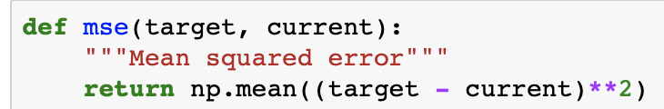
MSE CALCULATION
TWO DIFFERENT MSE calculations:
Indicators’ Percentage Growth
Indicator’s Absolute Value
The MSE formula is the same:
Overall MSE are the mean of indicators
Notes:
Eddie could you help with this?

Slide 4
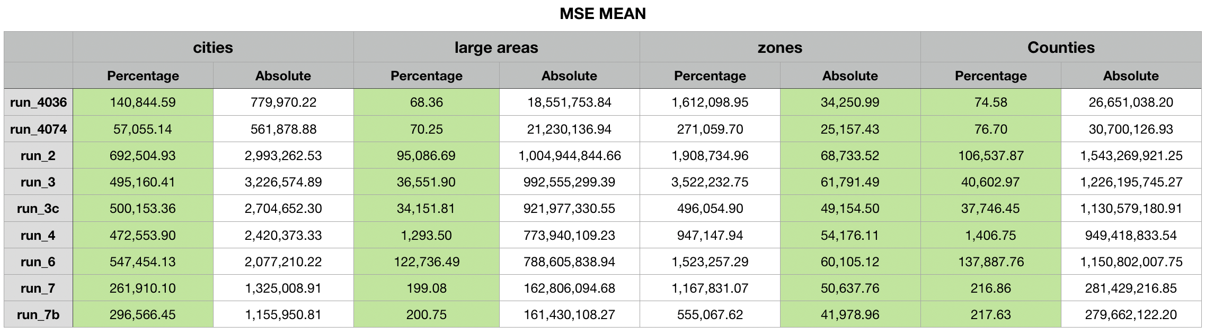
MSE CALCULATION
Notes:
1 -RUN 4036
2- SIMPLIFIED RUN WITH REGIONAL SPECIFICATIONS (Accessibility Variables) (run_simplified_regional_accessvars.h5) DONE
3- SIMPLIFIED RUN WITH REGIONAL SPECIFICATIONS (Clustering Variables) (run_simplified_regional_clustvars.h5) DONE
3-B. SIMPLIFIED RUN WITH REGIONAL AND UNIT-LEVEL HLCMS SPECIFICATIONS (Clustering Variables) - Done!
3-C. SIMPLIFIED RUN WITH REGIONAL AND UNIT-LEVEL LCMS SPECIFICATIONS (Clustering Variables) - Done!
4- SIMPLIFIED RUN WITH LARGE-AREA CONTROL SPECS (Clustering Variables) (run_simplified_largearea_control_clustvars.h5) DONE
6- SEMCOG AS IS WITH REGIONAL SPECIFICATIONS (Clustering Variables) (run_semcog_regional_clustvars.h5) DONE
7- SEMCOG AS IS WITH LARGE AREA CONTROL SPECIFICATIONS (Clustering Variables): (run_semcog_lacontrol_clustvars.h5) DONE
7-B. SEMCOG AS IS WITH LARGE AREA CONTROL AND UNIT LEVEL LCMS SPECIFICATIONS (Clustering Variables) running generate indicators
run_semcog_la_control_clustvars_unit_level
7-C SEMCOG AS IS WITH LARGE AREA CONTROL AND UNIT LEVEL LCMS SPECIFICATIONS AND CALIBRATED HLCMS run_semcog_lacontrol_clustvars_calibhlcms
WITH URBANSIM_TEMPLATES:
3-D.template. run_simplified_regional_clustvars_unit_level_templates.h5

Slide 5
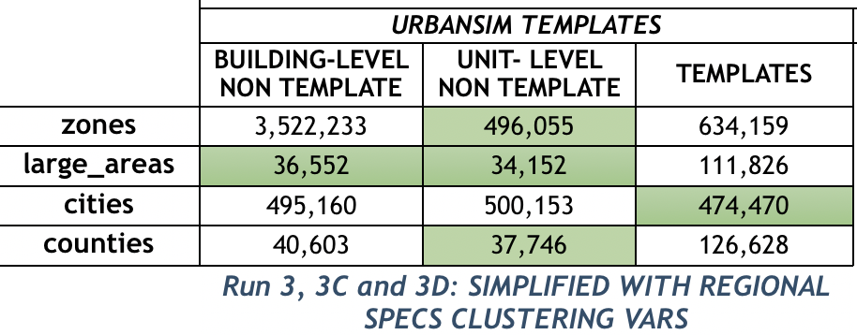
UrbanSim Templates
Templates use random sampling of building-level alternatives in estimation and simulation -> CONSISTENCY
Unit-level estimation, same consistency. That’s why zones and cities have the same magnitude

Slide 6
HLCM: RE-ESTIMATION
RE-Estimating HLCMs
Choosers = unplaced households after running transition and relocation models.
Choice = Building_id before being unplaced
Alternatives = Vacant residential units after running transition and relocation models

Slide 7
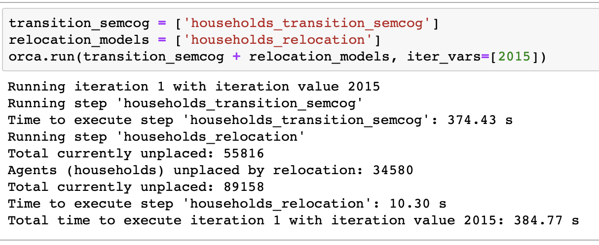
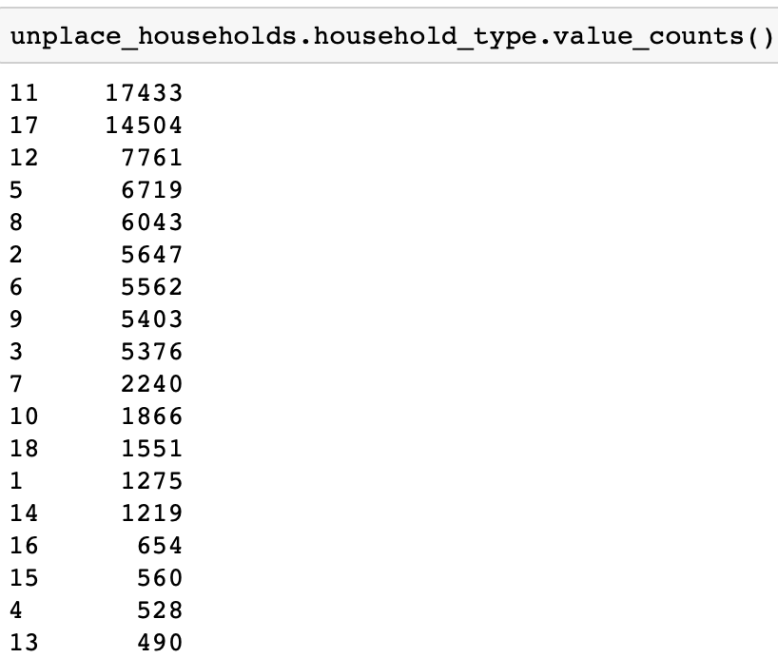
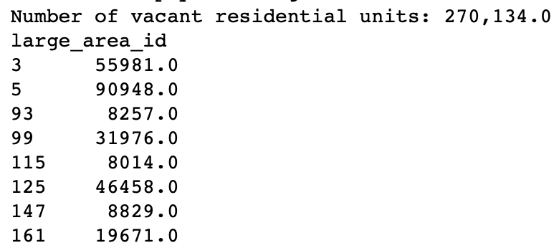
HLCM: RE-ESTIMATION

Slide 8
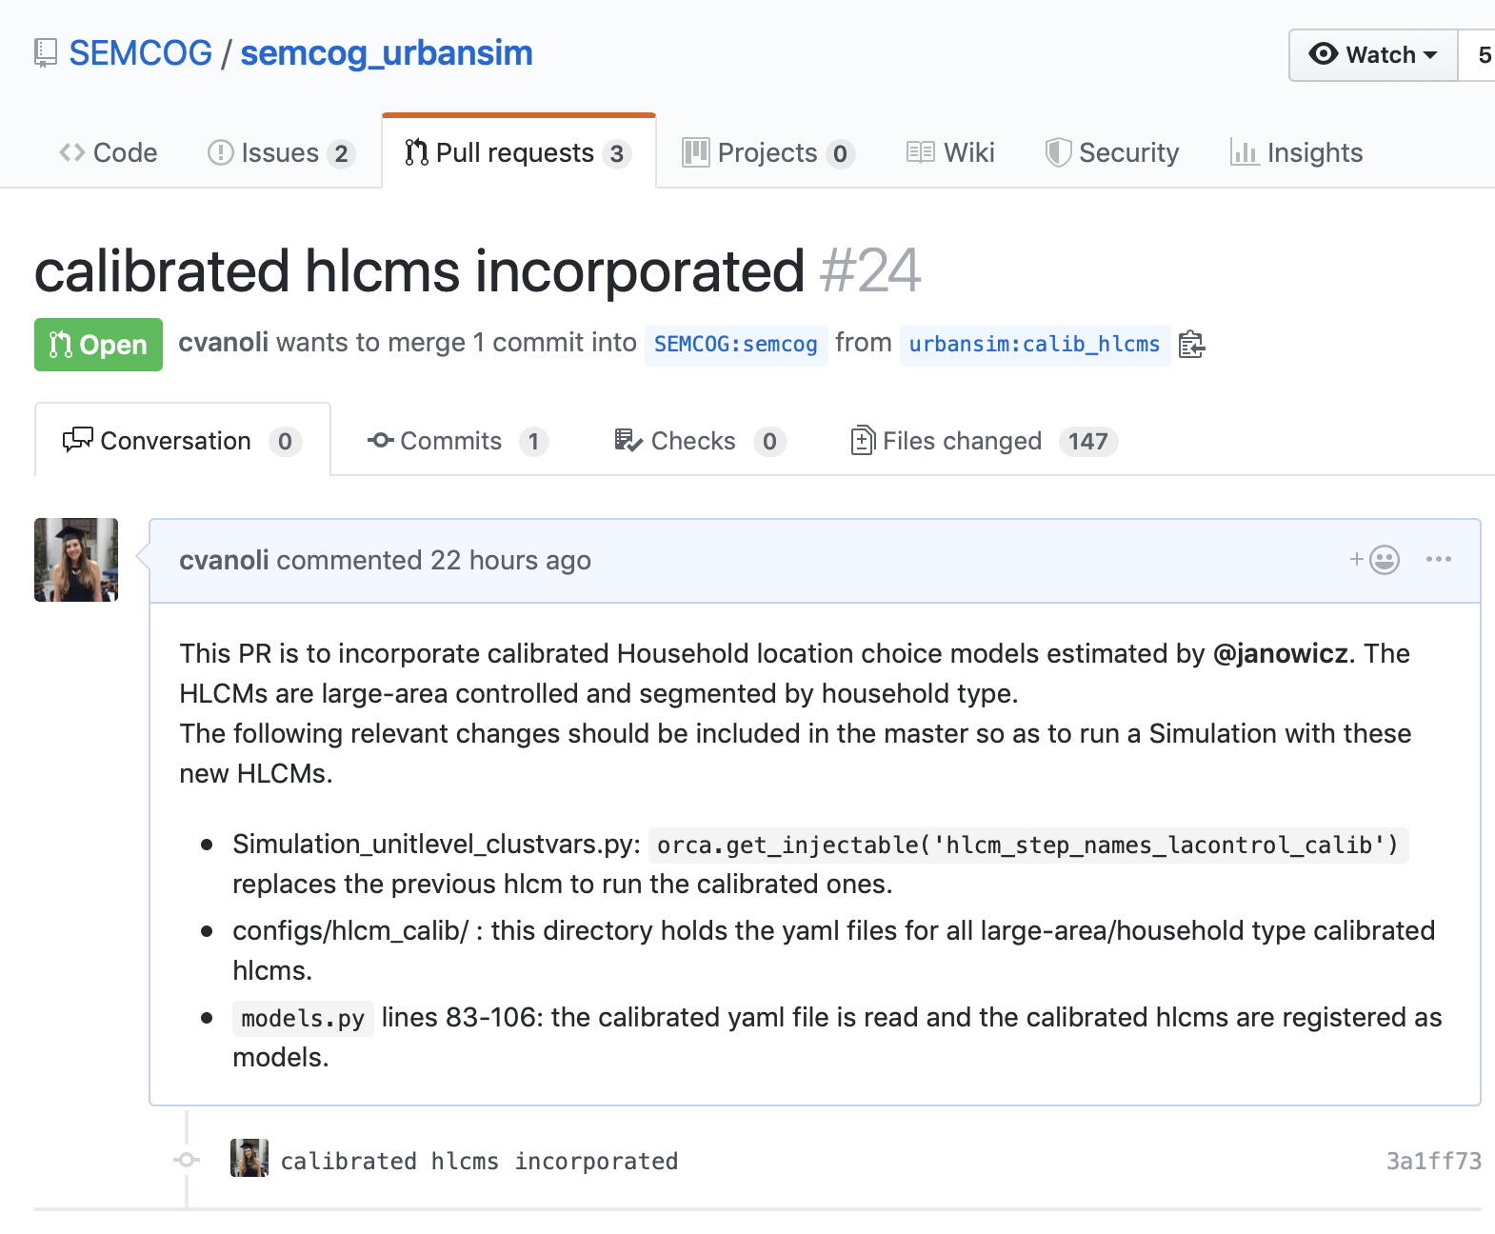
CALIBRATED HLCMS
PR on semcog_repo to run the Simulation on your end https://github.com/SEMCOG/semcog_urbansim/pull/24

Slide 9
CALIBRATED HLCMS
ON OUR END, WE ARE RUNNING:
RUN 4-B: SIMPLIFIED RUN WITH LARGE-AREA CONTROL SPECS, CALIBRATED HLCMS AND UNIT-LEVEL ELCMS
RUN 7-C: SEMCOG AS IS WITH LARGE-AREA CONTROL SPECS, CALIBRATED HLCMS AND UNIT-LEVEL ELCMS

